Slide 1

Funded by the European Union. Views and opinions expressed are however those of the author(s) only and do not necessarily reflect those of the European Union or the Tempus Public Foundation. Neither the European Union nor the granting authoriry can be held responsible for them.

Slide 2
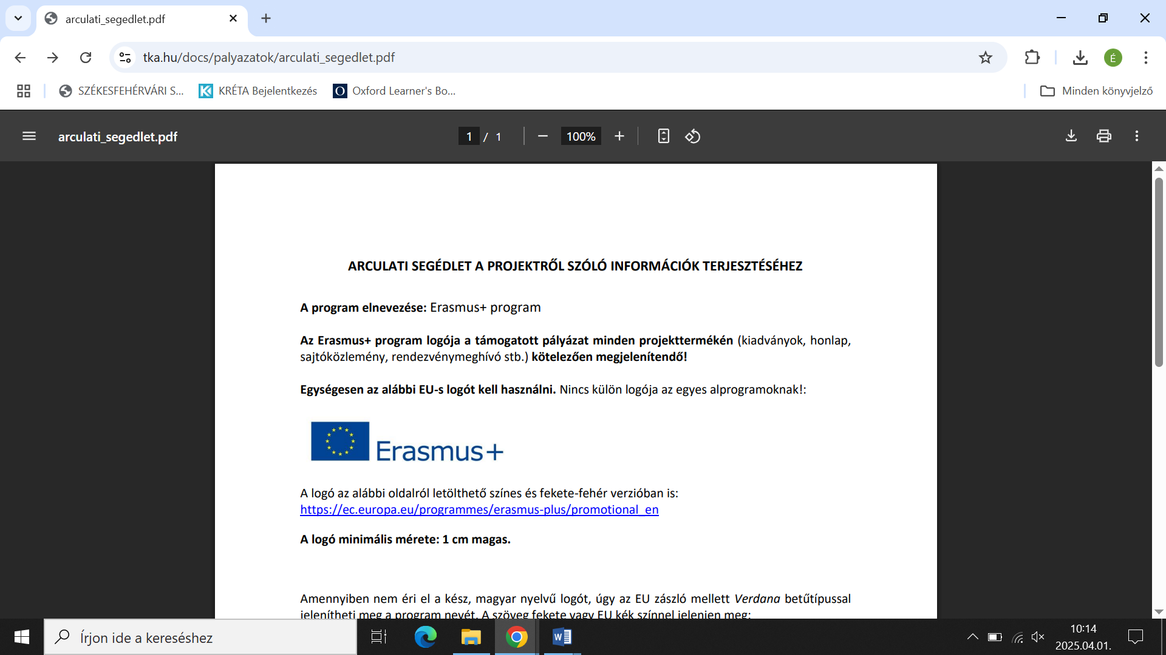
Discover the Green Life with Robots
2023-1-HU01-KA210-VET-000156243

Slide 3

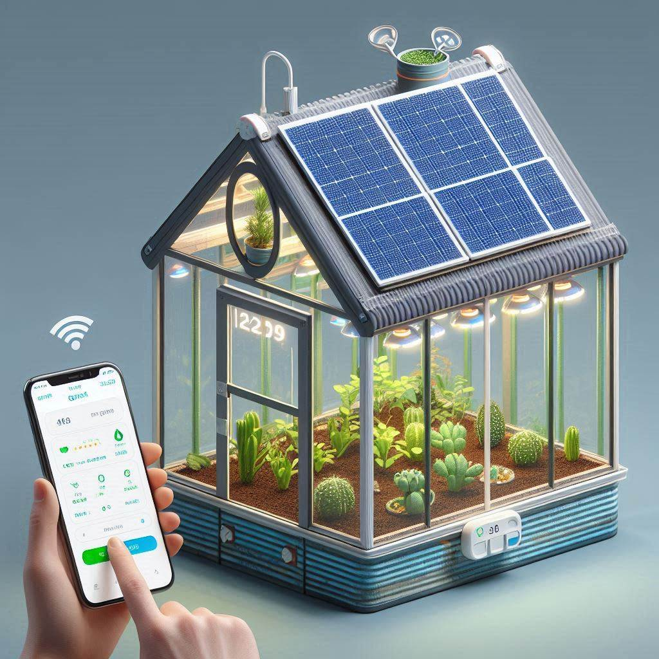
Mini greenhouses and microcontrollers
Created by:
Széchenyi – Székesfehérvár - HUN

Slide 4

Introduction of the project
Principles of smart greenhouse technology
Creating a miniature smart greenhouse model using Arduino
Work in teams to develop a functional model
Monitor and control temperature, humidity, and light levels.

Slide 5

Structure of the presentation
Role of greenhouses and microcontrollers
What is Arduino UNO and Mega and the comparison of them
Role of sensors and their importance in the smart plant grower
Types of sensors
Intervening devices

Slide 6
Mini greenhouses

Slide 7
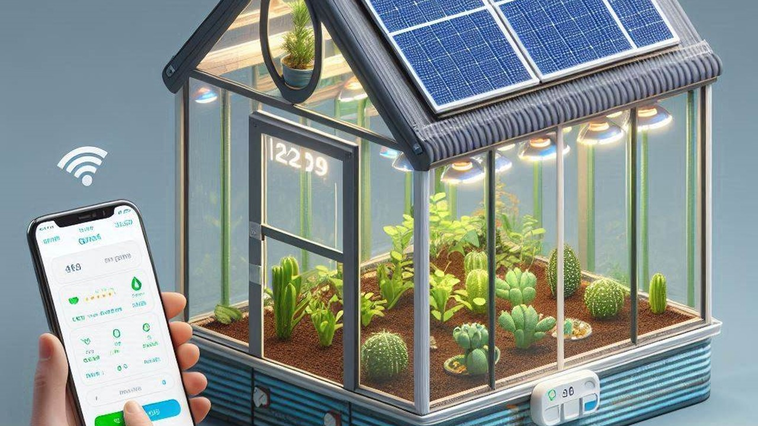

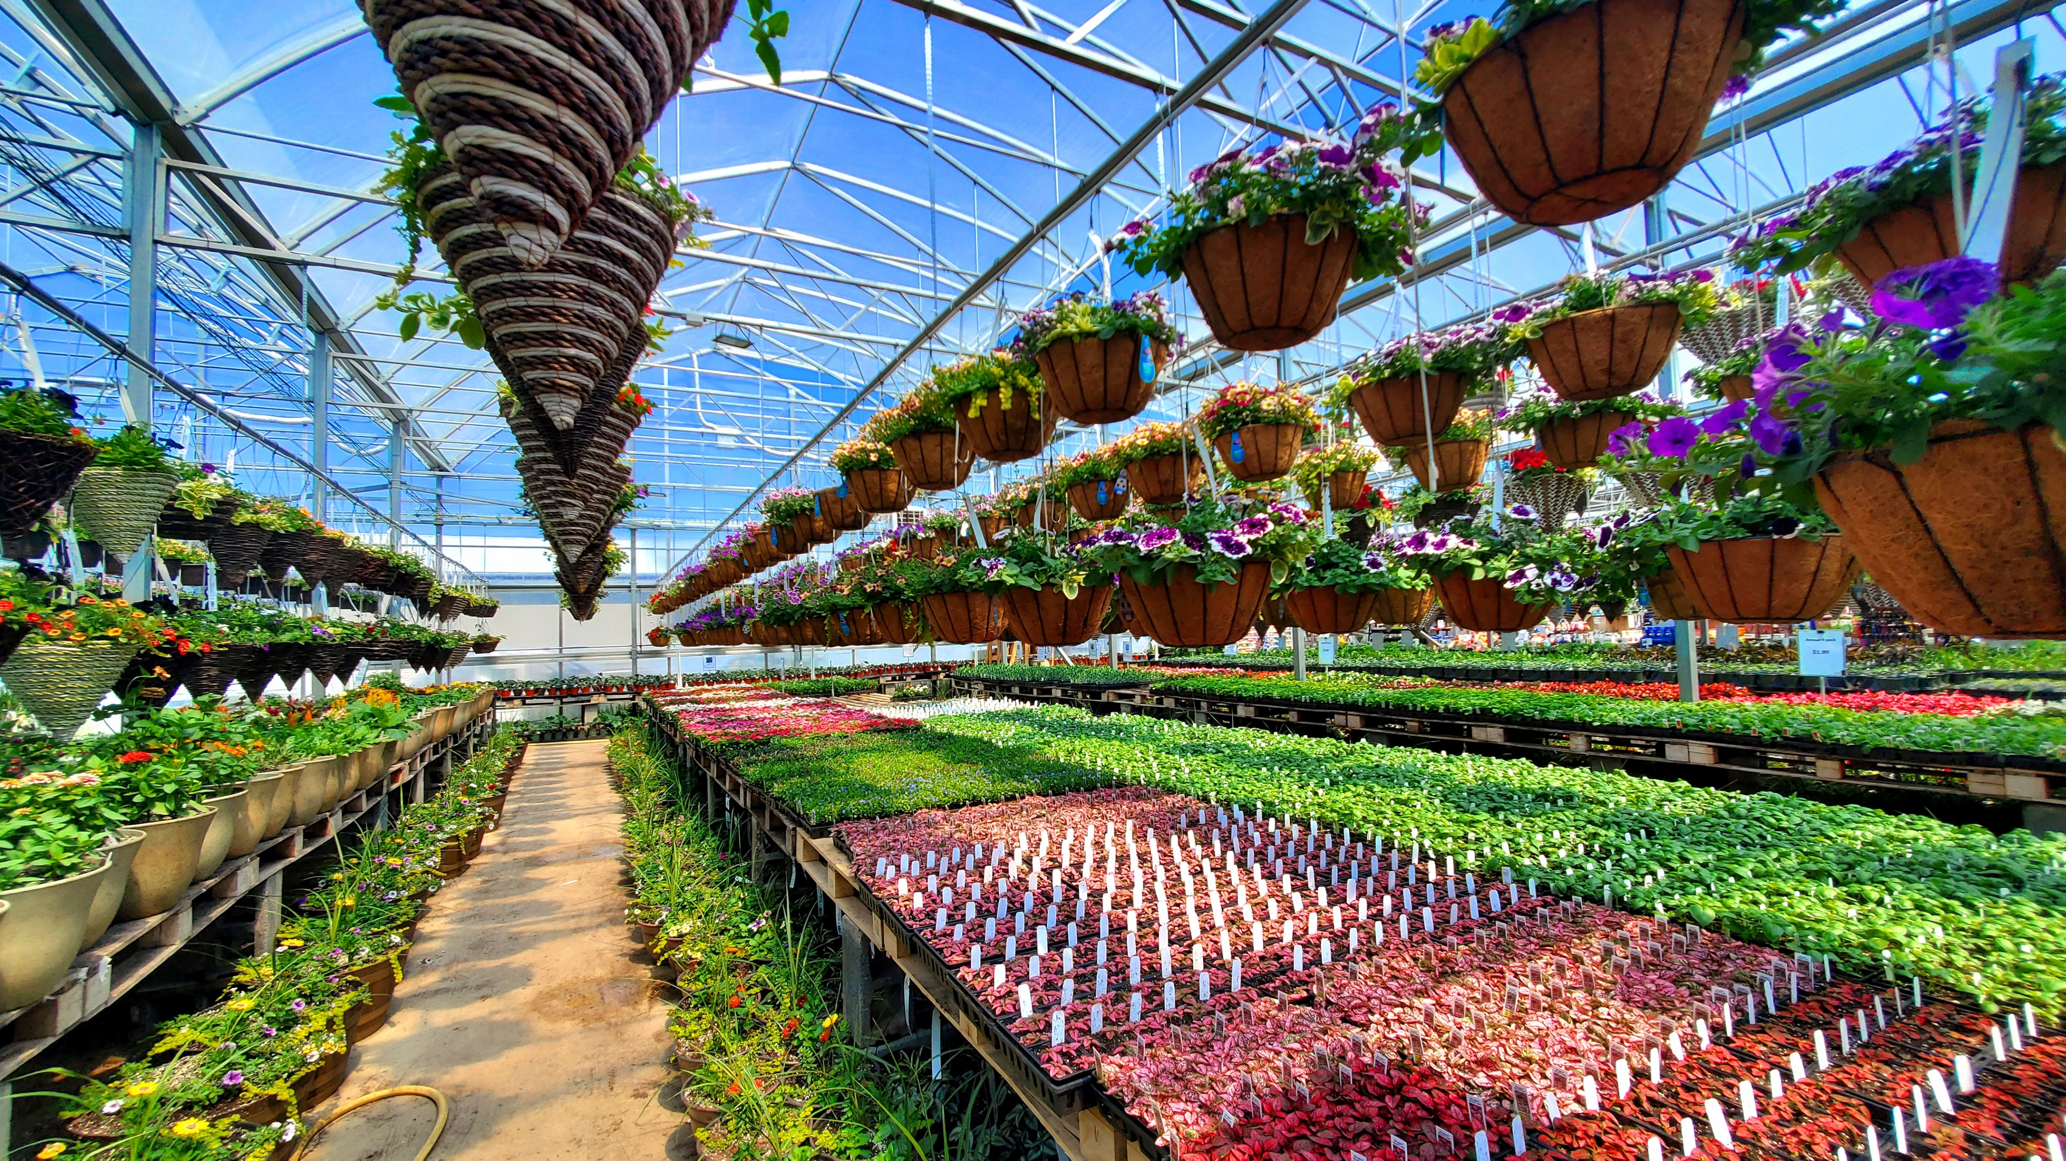

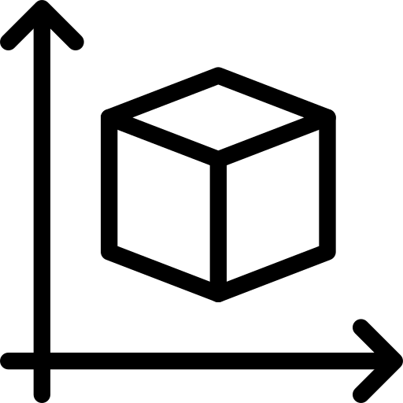

Transparent materials
Polycarbonate
Glass
Light Transmission
Polycarbonate: 80 -90%
Glass: 90 – 95%
Natural Ventilation
Mechanical Ventilation
Automated Ventilation
Small – indoor
Width – 75 cm
Height – 90 cm
Depth – 60 cm
Medium – outdoor
Width – 105 cm
Height – 150 cm
Depth – 75 cm
Larger models – outdoor
>210cm tall
More space
Control Systems
microcontroller
programmable controller
Control – Monitoring
smartphone app
Computer
Communication
Wi-Fi
Bluetooth
Basic
INFORMATION

Slide 8
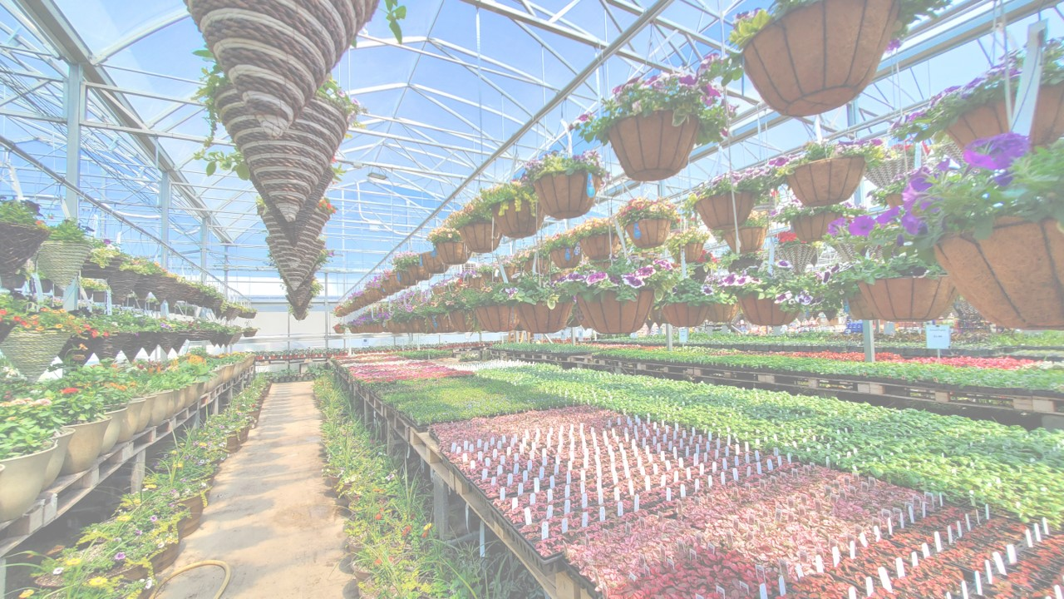
Small – indoor
Width – 75 cm
Height – 90 cm
Depth – 60 cm
Medium – outdoor
Width – 105 cm
Height – 150 cm
Depth – 75 cm
Larger models – outdoor
>210cm tall
More space
Transparent materials
Polycarbonate
Glass
Light Transmission
Polycarbonate: 80 -90%
Glass: 90 – 95%
Natural Ventilation
Mechanical Ventilation
Automated Ventilation
Control Systems
microcontroller
programmable controller
Control – Monitoring
smartphone app
Computer
Communication
Wi-Fi
Bluetooth

Slide 9
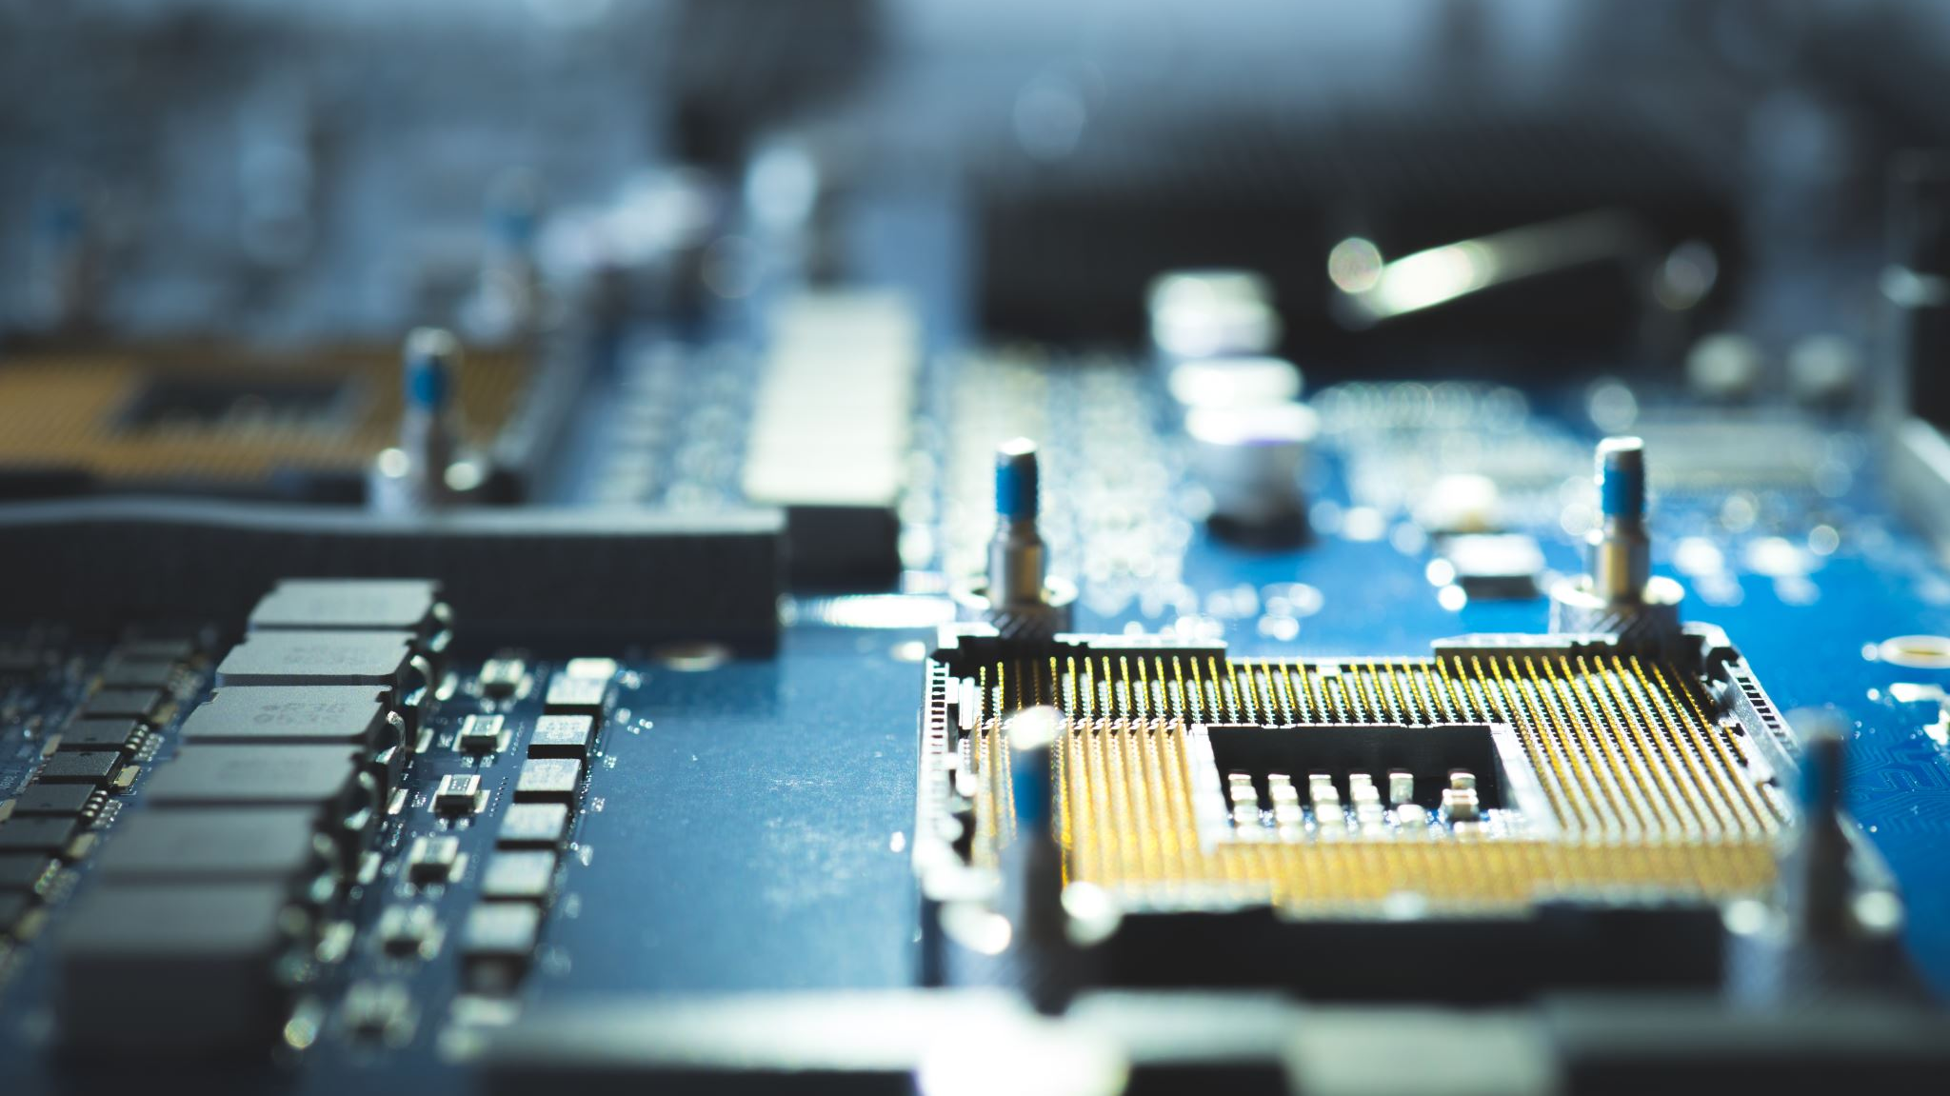
MICROCONTROLLERS
Transparent materials
Polycarbonate
Glass
Light Transmission
Polycarbonate: 80 -90%
Glass: 90 – 95%
Natural Ventilation
Mechanical Ventilation
Automated Ventilation
Small – indoor
Width – 75 cm
Height – 90 cm
Depth – 60 cm
Medium – outdoor
Width – 105 cm
Height – 150 cm
Depth – 75 cm
Larger models – outdoor
>210cm tall
More space
Control Systems
microcontroller
programmable controller
Control – Monitoring
smartphone app
Computer
Communication
Wi-Fi
Bluetooth

Slide 10

Microcontrollers
A microcontroller is like a tiny computer packed into a single chip.
It can be found in everyday devices, like your microwave, TV remote, or even a toy. Its job is to control how these devices work.

Slide 11
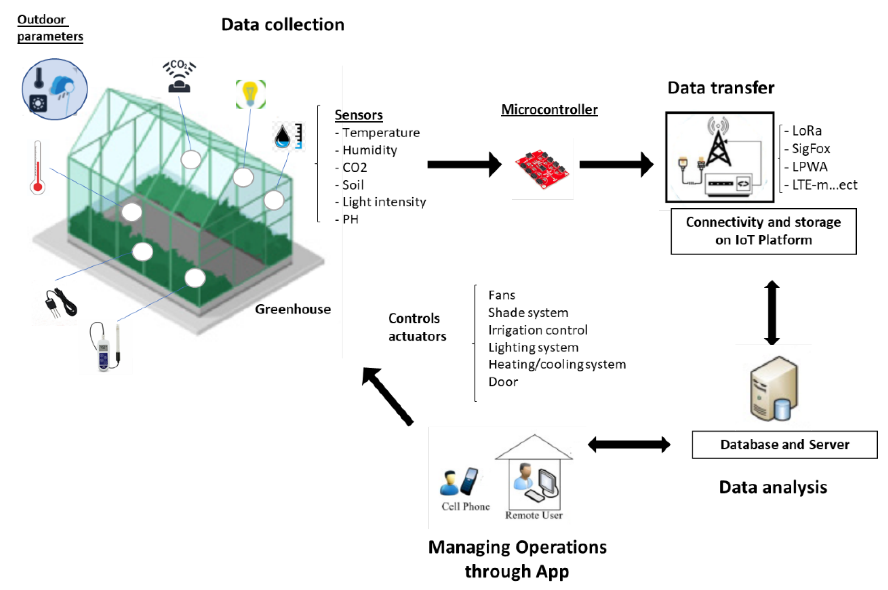
Process

Slide 12
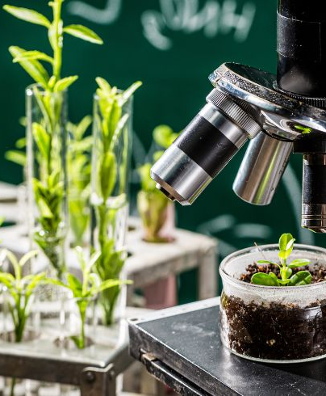
Why are smart greenhouses important?
Boost Plant Health
Save Time and Effort
Reduce Human Error

Slide 13
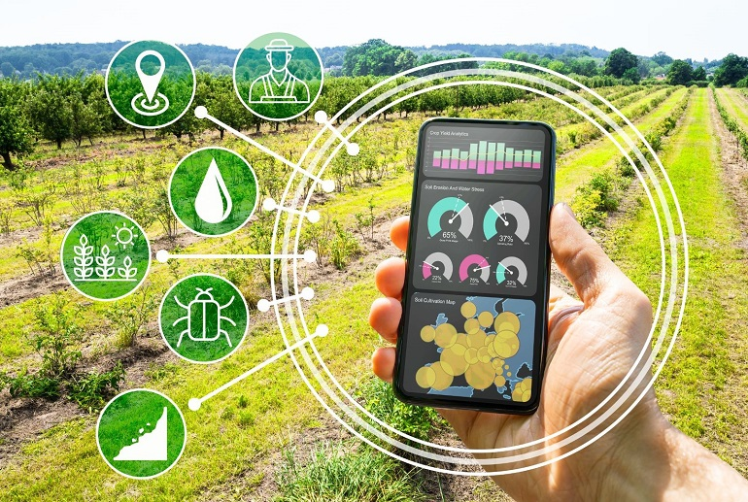
Basic functions of microcontrollers
Temperature Control
Humidity Regulation
Light Management
Soil Moisture Monitoring – Hydration
Ventilation
Data Logging

Slide 14




Advantages
Automation
Precision
Energy Efficiency
Customizability
Remote Monitoring
Complexity
Dependence on Sensors
Limited Processing Power
Maintenance
Initial Setup Cost
disadvantages

Slide 15

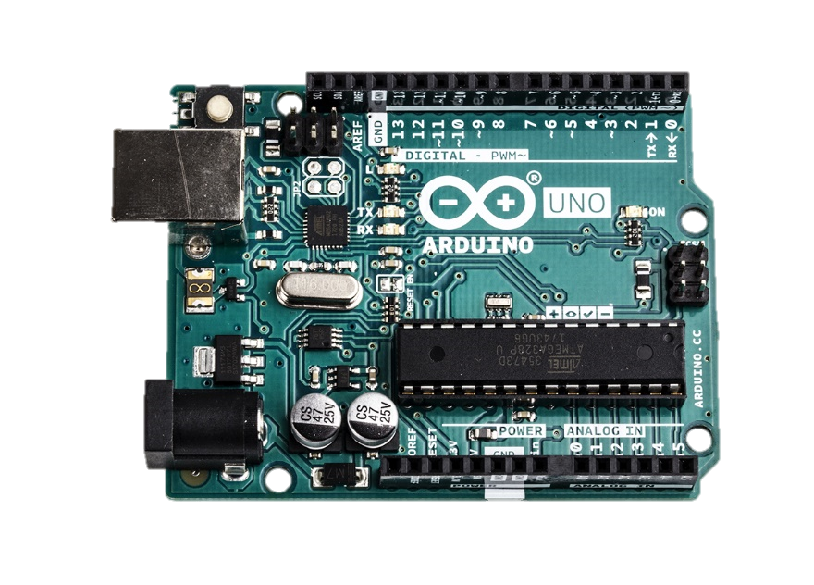
Arduino Uno
For:
Hobbyists,
students,
and professionals

Slide 16

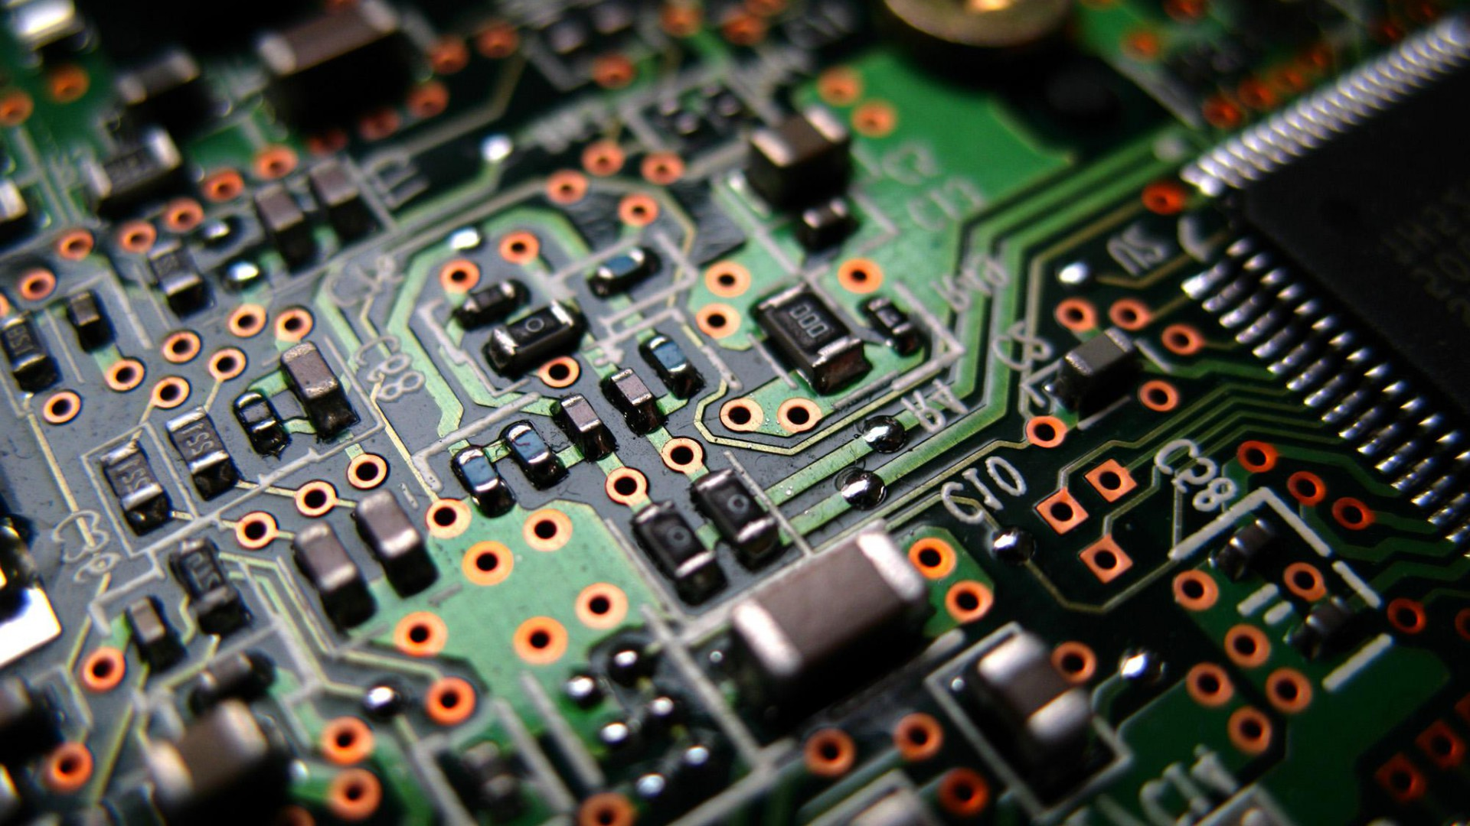
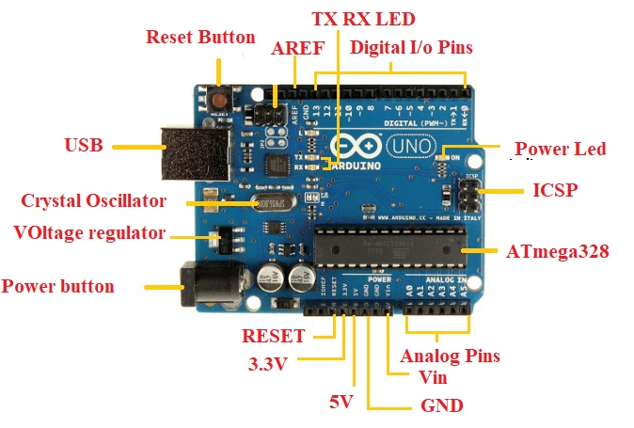
Parts

Slide 17
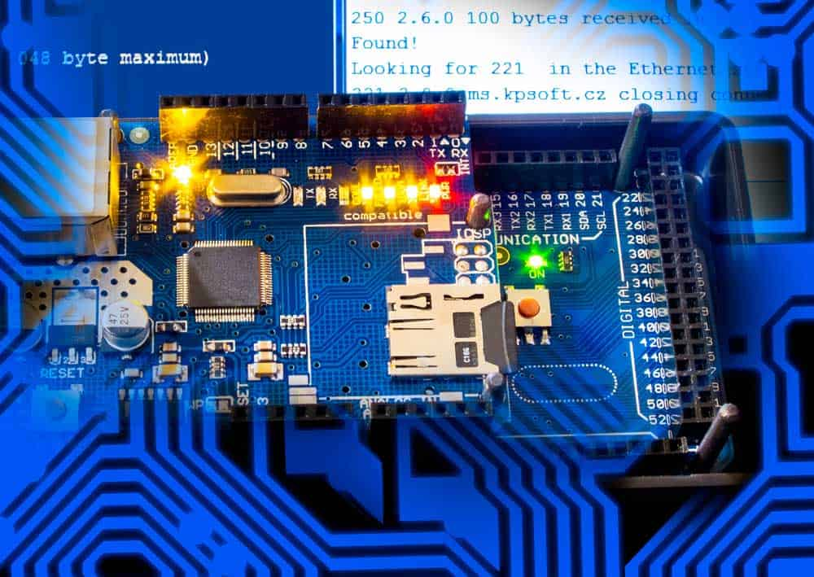
Basic functions:
Digital Input/Output (I/O)
Analog Input, PWM Output
Power Supply
Serial Communication (UART)
Timers and Interrupts
LED Indicator
Reset Button
Integrated Development Environment Support

Slide 18
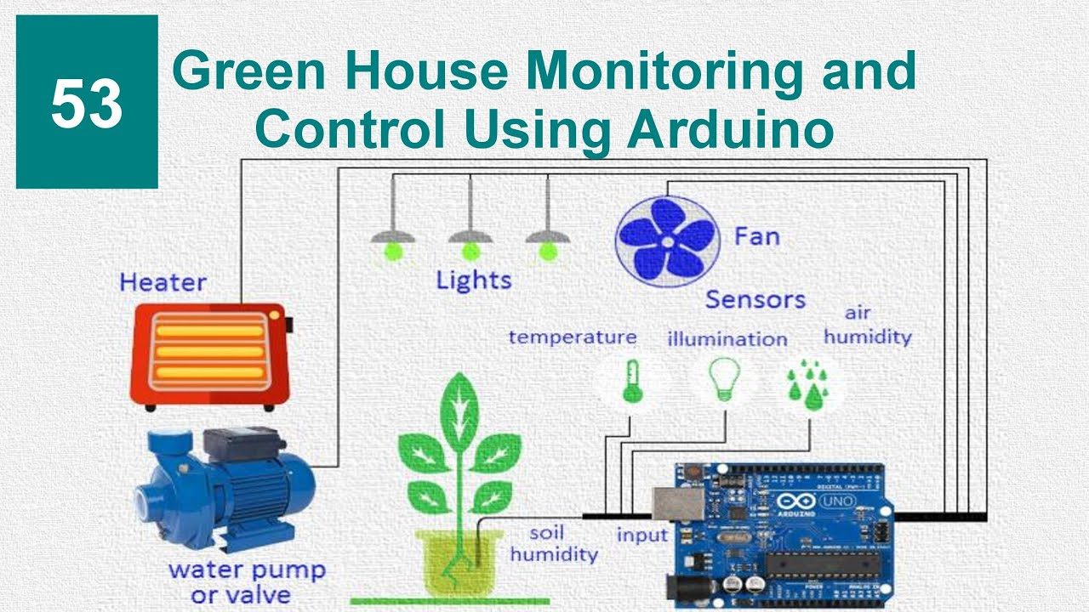
Uses in our world
Control Lights (LEDs)
Sense the Environment (Sensors)
Control Motors
Automate Tasks
Measure and Record Data
Time-Based Automation (Real-Time Clock)

Slide 19
disadvantages
Limited Processing Power
Limited Memory
No Native Wireless Capabilities
Lower Precision on Analog Inputs
Limited I/O Pins:
Easy to Use
Affordable
Open Source
Wide Compatibility
Cross-Platform
Advantages

Slide 20
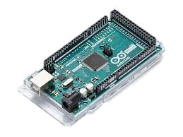
Arduino Mega
For:
Advanced hobbyists,
students,
and professionals

Slide 21

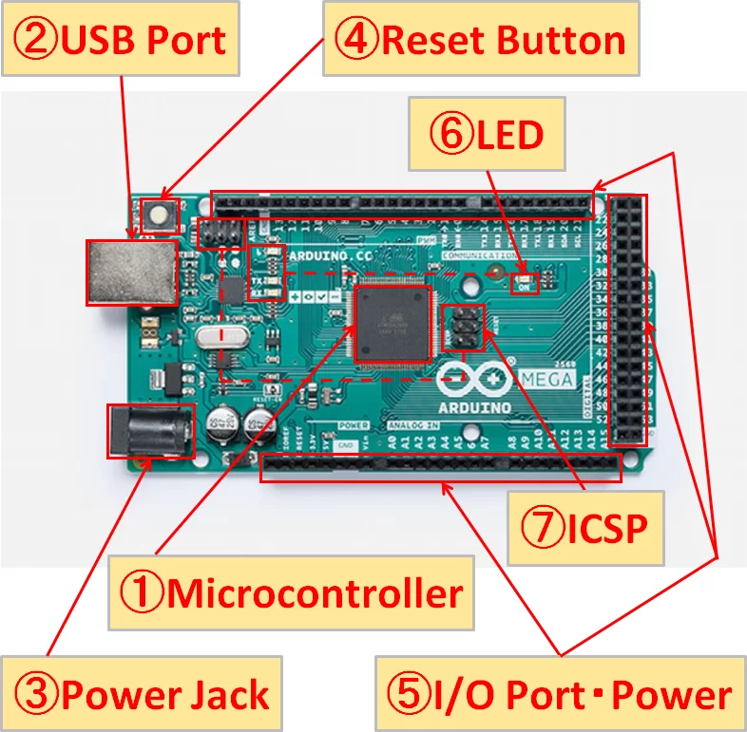
Parts

Slide 22

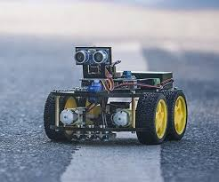
Overwiev of Arduino Mega
Microcontroller board
54 digital input/output pins
16 analog inputs
USB connection
Power jack
Reset button
LED

Slide 23
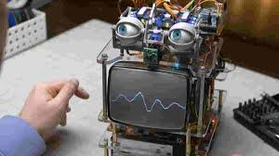
Main features
Length: 101.52 mm
Width: 53.3 mm
Weight: 37 g
Flash memory: 256 KB
Operating voltage: 5 V

Slide 24
DISADVANTAGES
CPU
Little 5 V regulator
Terrible stock bootloader
Memory space
Higher processing power
Easy to use
ADVANTAGES

Slide 25
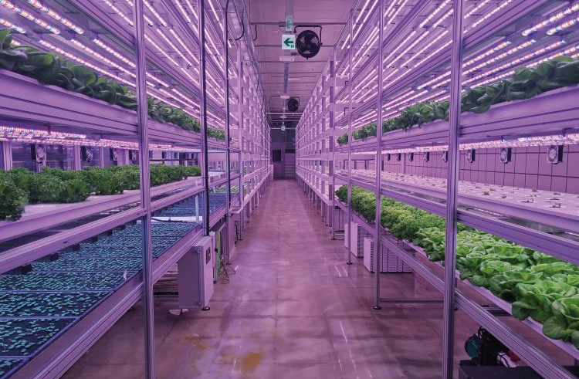
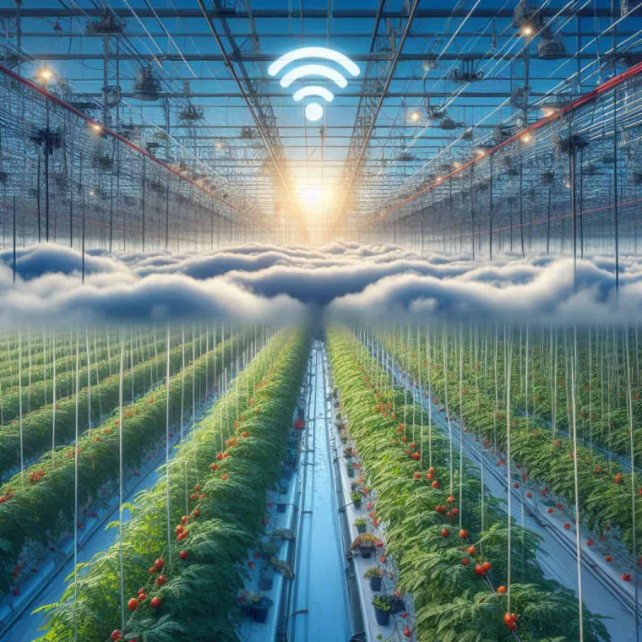
Sensors and Intervention Devices

Slide 26
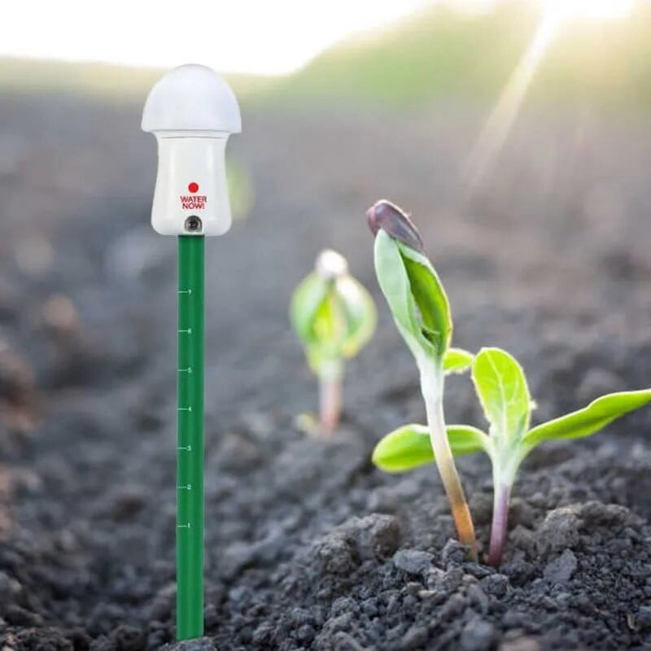
Importance of sensors
Environmental Monitoring
Automated Control
Resource Efficiency
Problem Detection

Slide 27
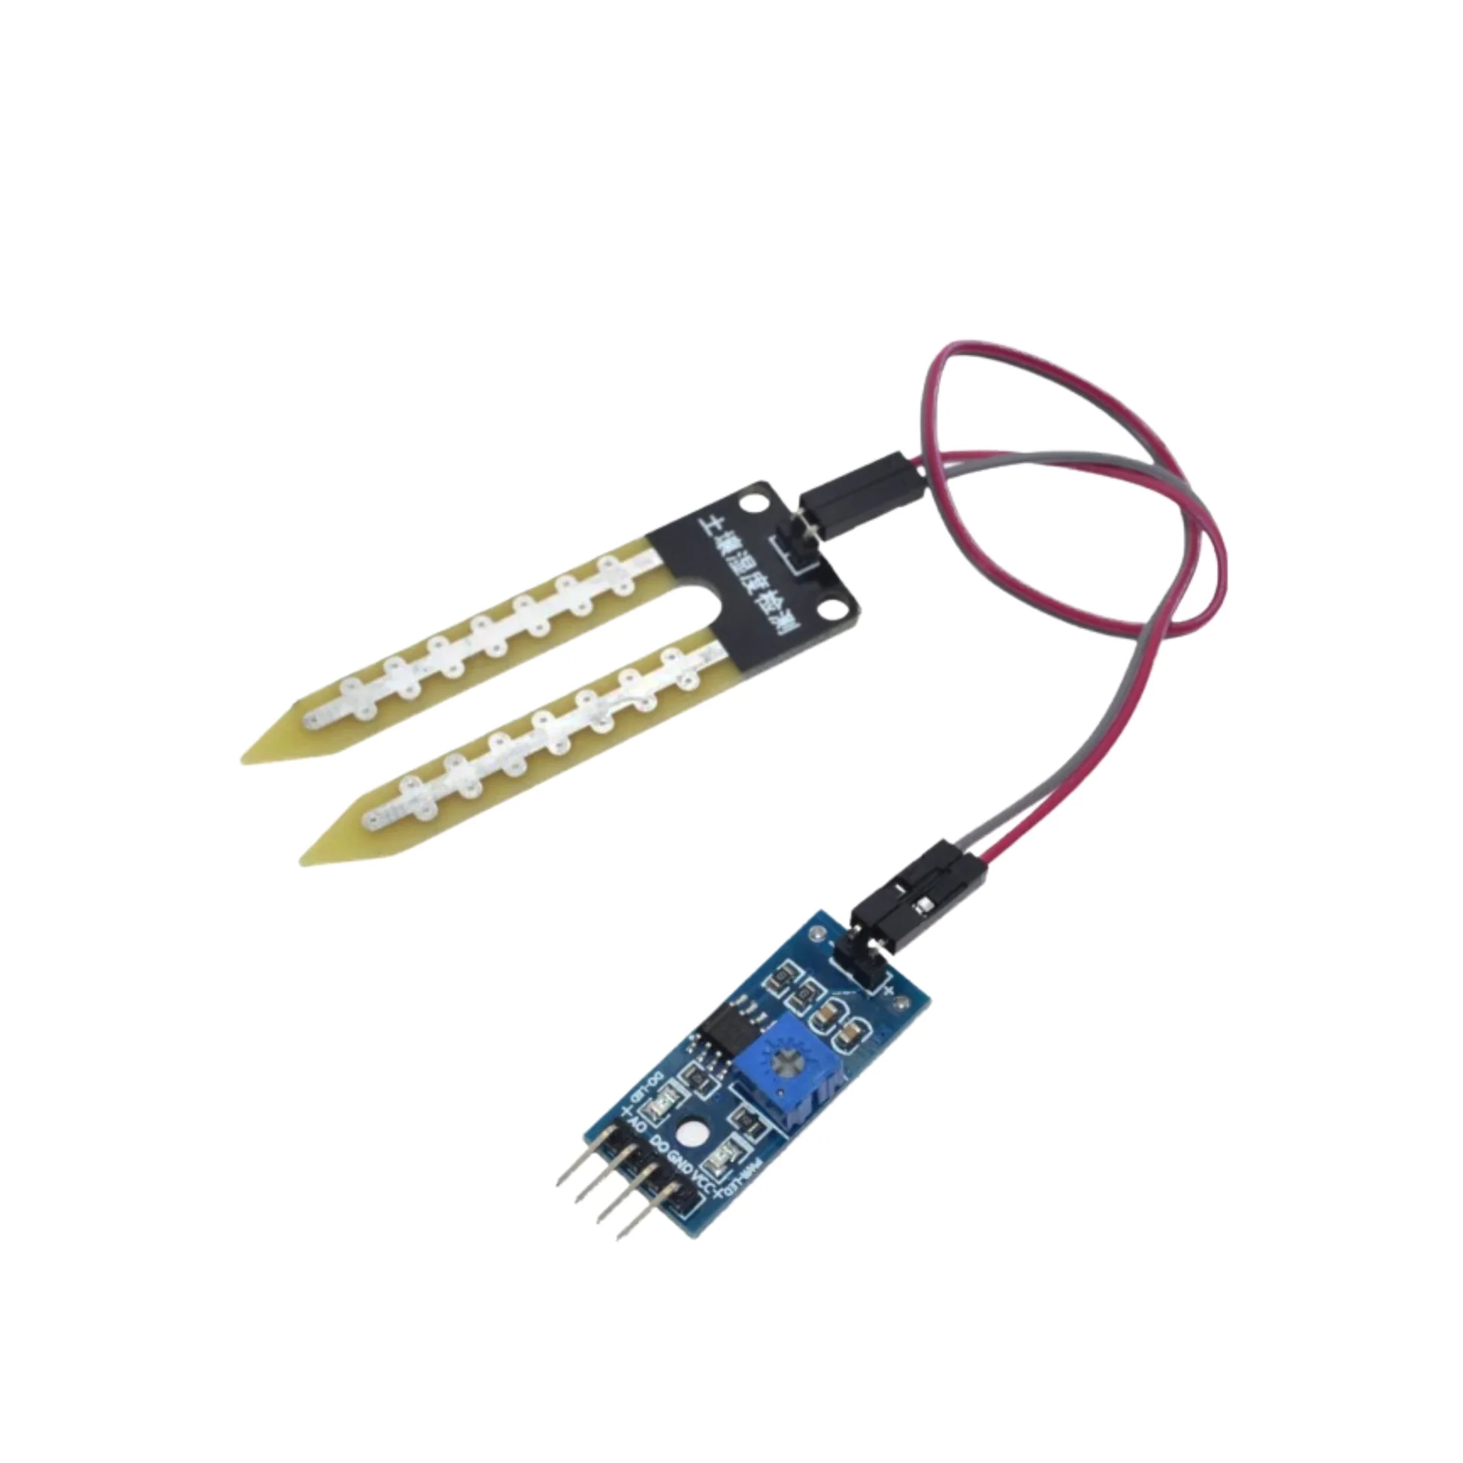
Moisture sensor
Operating Process:
Two Electrodes
Conductivity Measurement
Data Transmission

Slide 28
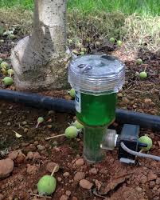
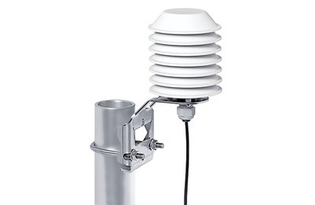
Applications of Moisture Sensors
Horticulture & Greenhouses
Water Management
Meteorology
Construction
Soil Research

Slide 29
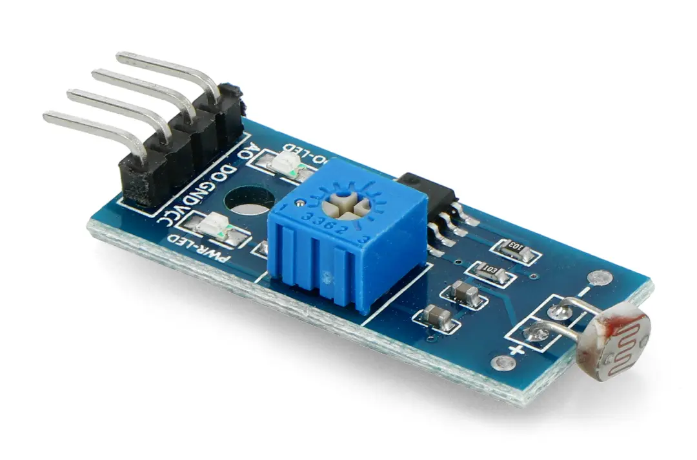
What Are Light Sensors?
Definition
How They Work

Slide 30
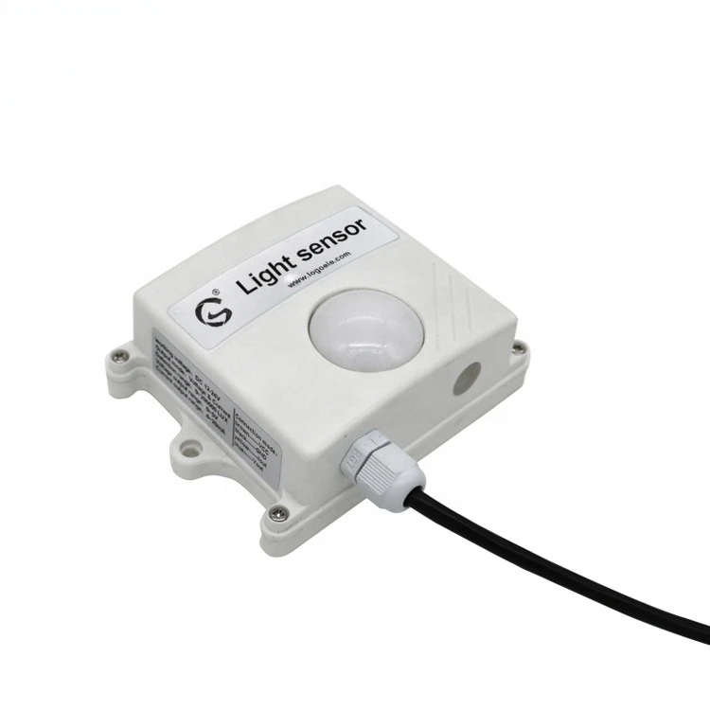
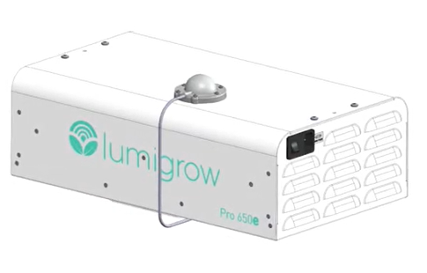
Applications in Greenhouses
Supporting Plant Growth
Automatic Lighting Control

Slide 31
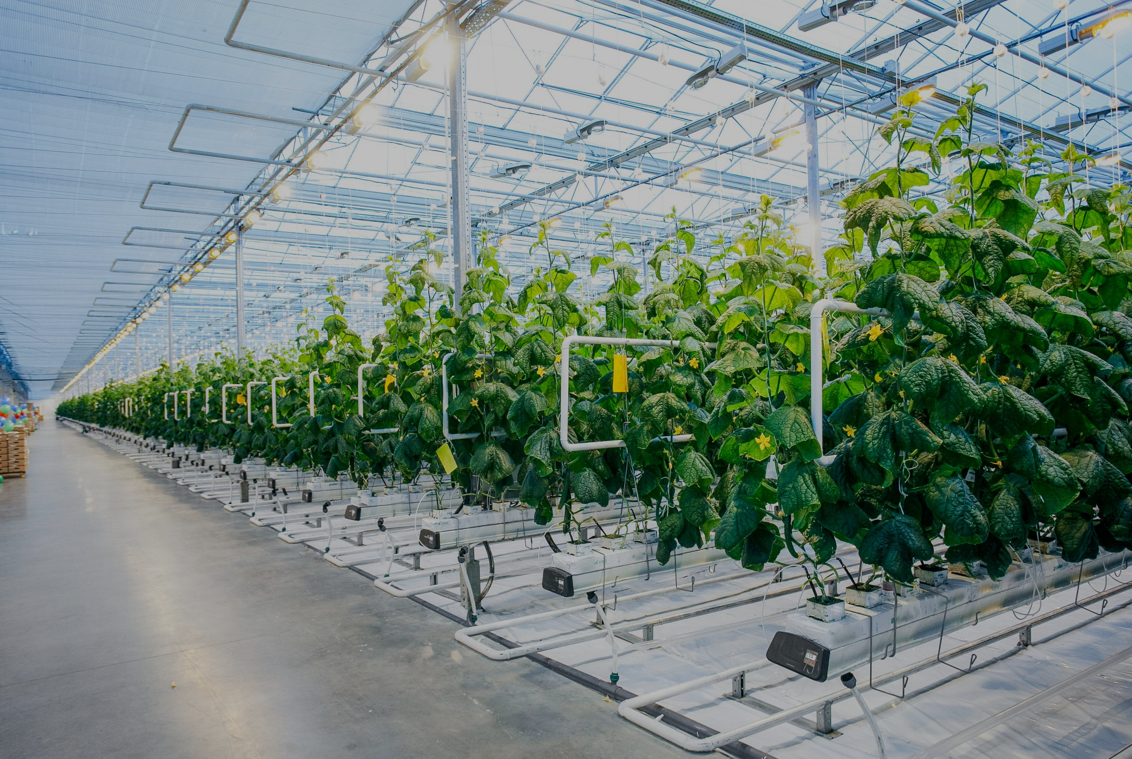
What are Heat Sensors
Definition
How They Work

Slide 32
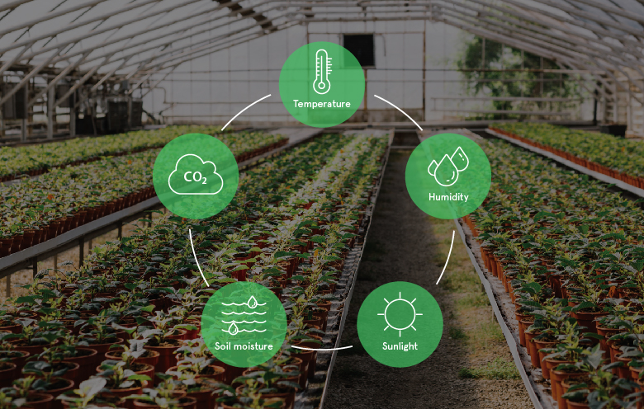
Applications in Greenhouses
Temperature Control
Automated Climate Management

Slide 33
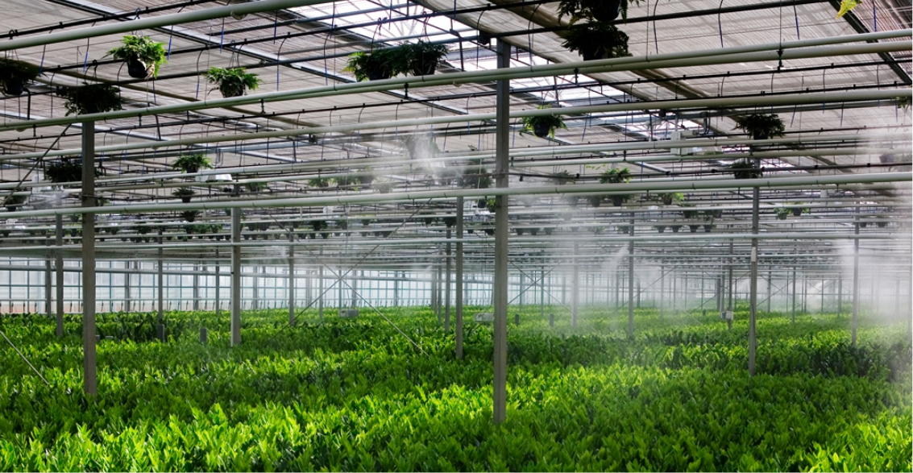
Vape System

Slide 34

Introduction
What are Vapor Sensors?
Sensors that measure the amount of water vapor present in the air

Slide 35
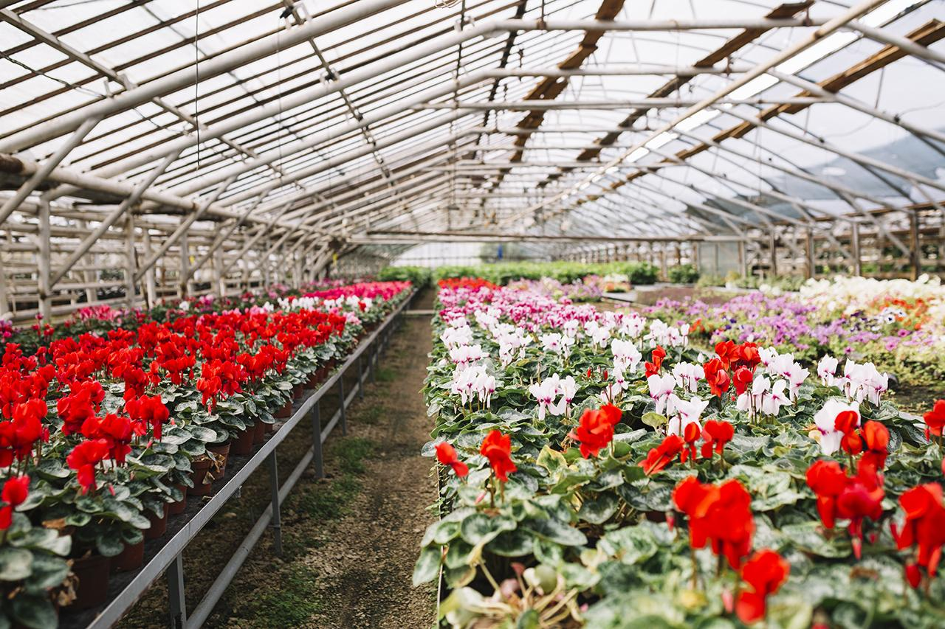
Types of Vapor Sensors
Capacitive Sensors
Resistive Sensors
Thermal Conductivity Sensors

Slide 36
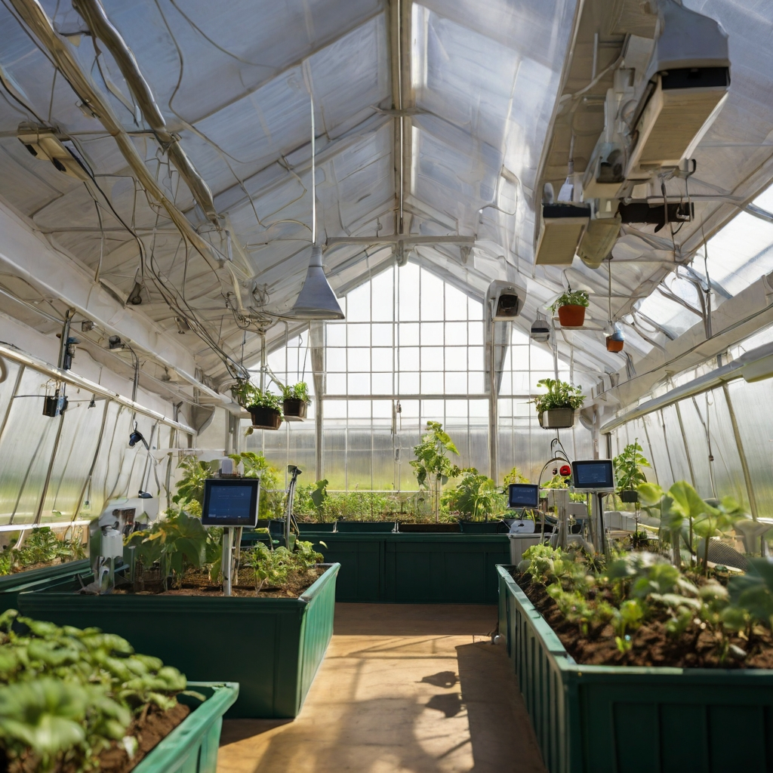
Intervention Devices

Slide 37
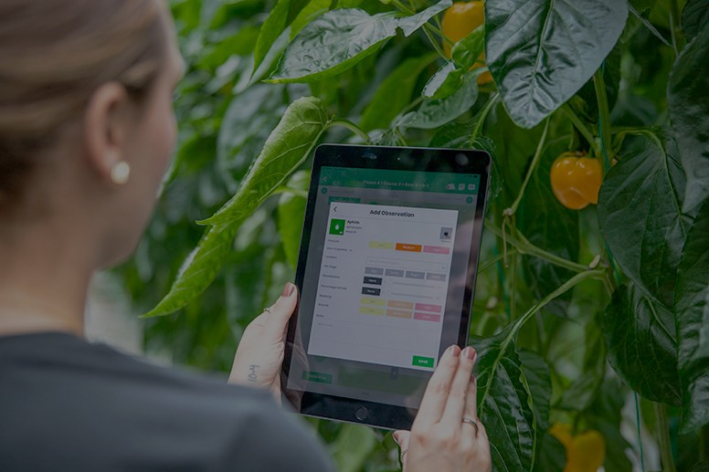
Types of Intervention Devices
Ventilation system
Heating system
Irrigation system
Lighting system

Slide 38

Despite technological advances, the relationship between people and plants remains important

Slide 39

Thank you for your attention!

