Slide 1

Discover the Green Life with Robots 2023-1-HU01-KA210-VET-000156243 Funded by the European Union. Views and opinions expressed are however those of the author(s) only and do not necessarily reflect those of the European Union or the Tempus Public Foundation. Neither the European Union nor the granting authoriry can be held responsible for them.

Slide 2
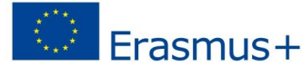
Discover the Green Life with Robots 2023-1-HU01-KA210-VET-000156243

Slide 3
Energy Storage
Presented by Richárd, Dániel and Dávid

Slide 4
Agenda
1
2
3
4
What is energy is energy stroage?
The purpose of energy storage
Disadvantages of energy storage
Energy storage methods

Slide 5
1
What is energy storage?
Energy storage is the capture of energy produced at one time for use at a later time
Accumulator or Battery
Notes:
Energy storage is the capture of energy produced at one time for use at a later time to reduce imbalances between energy demand and energy production. A device that stores energy is generally called an accumulator or battery.

Slide 6
The purpose of energy storage
2
First case:
The power of the available energy source is not sufficient to cover the power demand.
Example: crossbow
Second case:
The energy is not always available in the amount that the consumer requires.
Examples: steam engines, piston pumps.
Notes:
Basically, energy needs to be stored in two cases. If the power of the available energy source is not sufficient to cover the power demand.példa: A classic example of this is the crossbow, in which, due to the limited human power. We can slowly pulled up through a gear transmission with little effort, and then the potential energy stored in the bow is released by pulling the trigger and that power transforms into kinetic energy. In other cases, the energy is not always available in the amount that the consumer requires. példa: In such cases, it is advisable to charge the energy storage from the excess energy and then discharge it when the consumption exceeds the energy produced. steam engines, piston pumps.

Slide 7
Disadvantages of energy storage
3
The system is divided into three well-separated subsystems:
Charging
Storage
Discharge subsystems
Subsystem have investment costs
The efficiency of the system is always less than 100%.
Notes:
The energy storage system is a significant investment cost. The system is divided into three well-separated subsystems:
– Charging,
– storage and
– discharge subsystems (this includes the one for the alternating current network
fitting as well).
All three subsystems have significant investment costs.
• The efficiency of the energy storage system is always less than 100%.

Slide 8
Energy storage methods
4
Kinetic energy
Potential energy
Compressed Air energy
Thermal energy
Magnetic energy
Battery energy
Hydrogen-based energy
Electrical energy

Slide 9



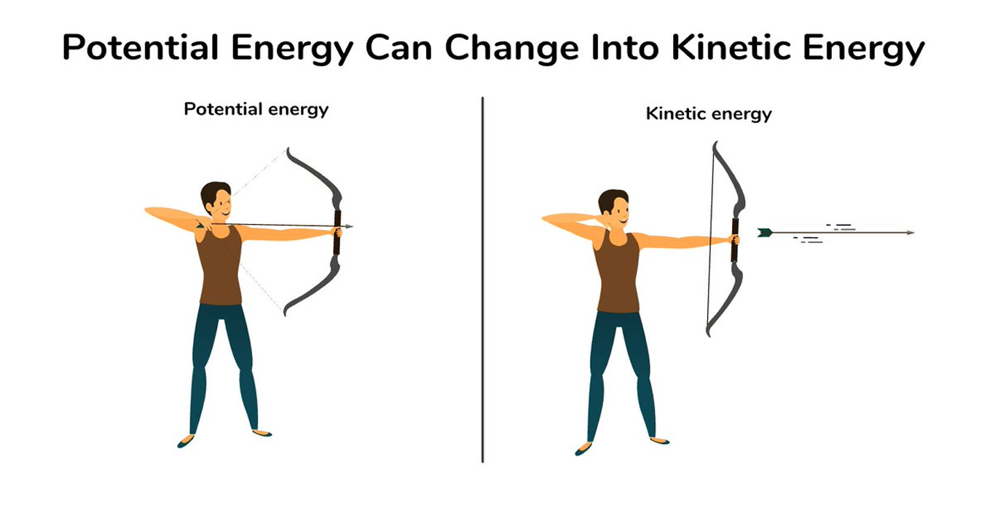
Kinetic energy storage
Advantages
How does it work?
Disadvantages
Notes:
like the crossbow
Advantages:
Long cycle life.
- Small size.
- Environmentally friendly.
– Low maintenance
Disadvantages:
Higher performances are still under development

Slide 10
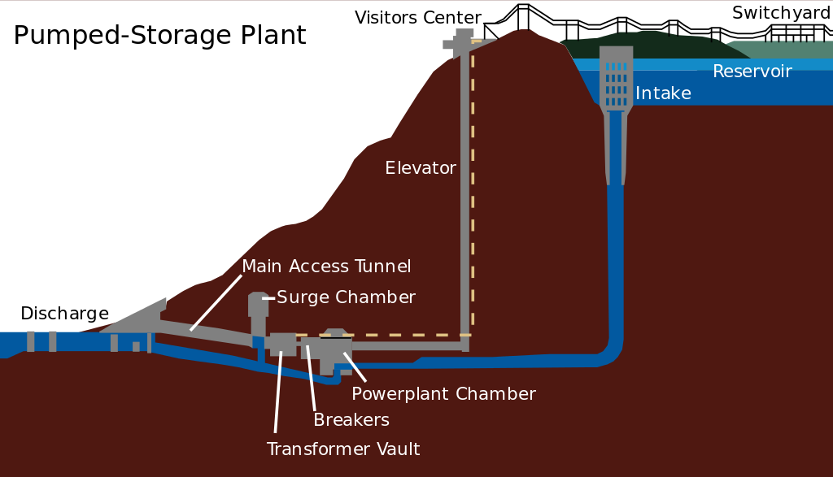
Potential energy storage
How does it work?
Advantages
Disadvantages
Notes:
Like pumped hydro
Extra off-peak energy or produced from renewable energy using electricity, this storage technology pumps water into a higher (mountain top) storage.
Advantages:
Widely used, mature, and fully developed energy storage technology.
Storage time is not limited
Disadvantages:
Environmental impacts are significant.

Slide 11
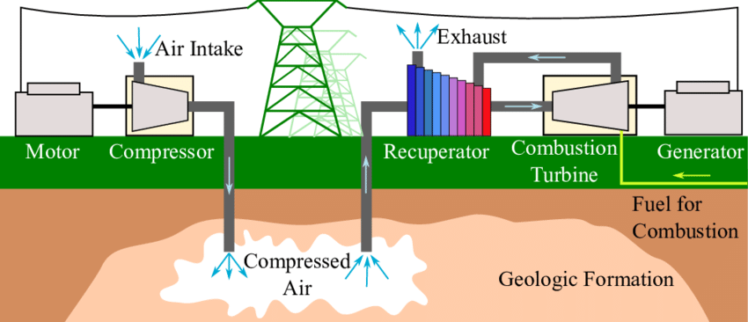
Compressed Air Energy Storage
How does it work?
Advantages
Disadvantages
Notes:
This storage technology compresses air
into an underground storage or spout system. Energy is compressed air
stored in its potential energy.
Advantages:
Used, mature technology
Wide performance and energy spectrum. Storage time is not limited
Disadvantages:
High capital requirement

Slide 12
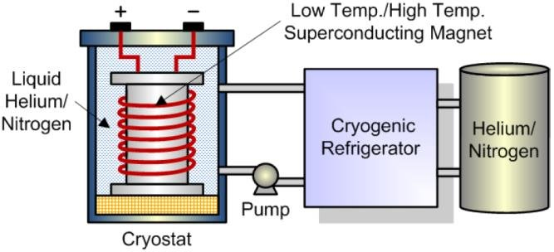
Magnetic energy storage
How does it work?
Advantages
Disadvantages
Notes:
generated energy is injected into an electromagnetic superconducting coil, and storage occurs in a magnetic field.
Advantages:
Very fast,
– A lot of energy can be released in a short time.
"Mature technology."
Disadvantages:
-Mainly suitable for short-term storage and discharge

Slide 13
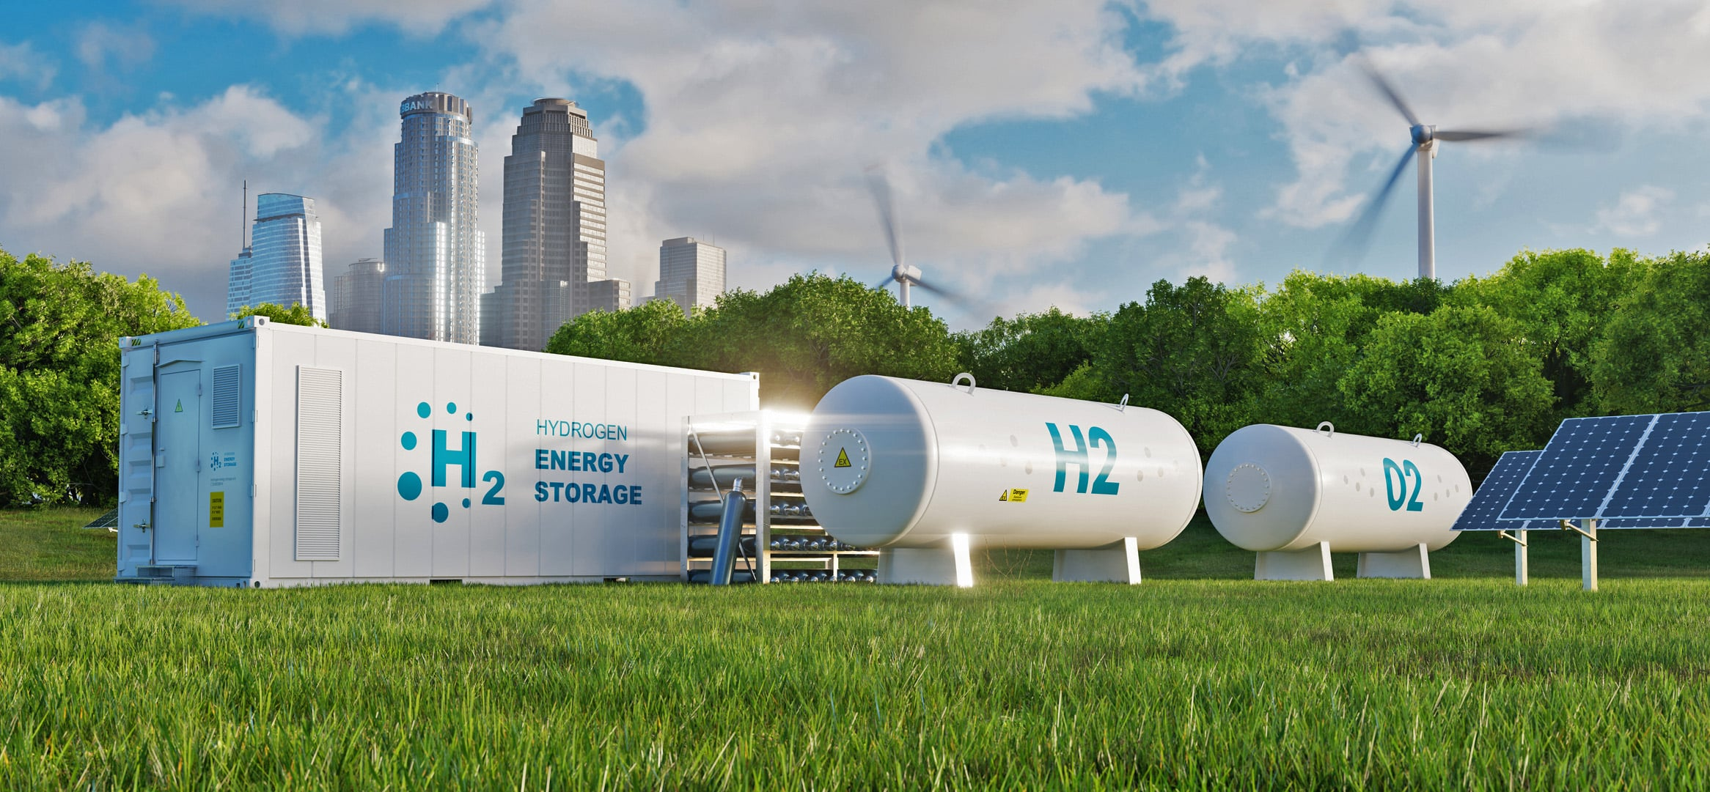
Hydrogen-based energy storage
How does it work?
Advantages
Disadvantages
Notes:
Hydrogen can be produced from electricity by electrolysis. Can be stored in a tank. Advantages: The storage period can be several months. Hydrogen can also be used for other purposes (e.g. in vehicles). Environmentally friendly. Disadvantage: Expensive Capital requirements: High capital requirements, mainly due to as yet undeveloped technologies

Slide 14
Battery energy storage
How does it work?
Advantages
Disadvantages
Notes:
Batteries store electricity in the form of chemical energy which can be converted back into electrical energy as needed. Advantages: Fast response to charging Quiet, non-polluting, so it can be placed close to the load. Disadvantage: Sensitive to temperature.

Slide 15
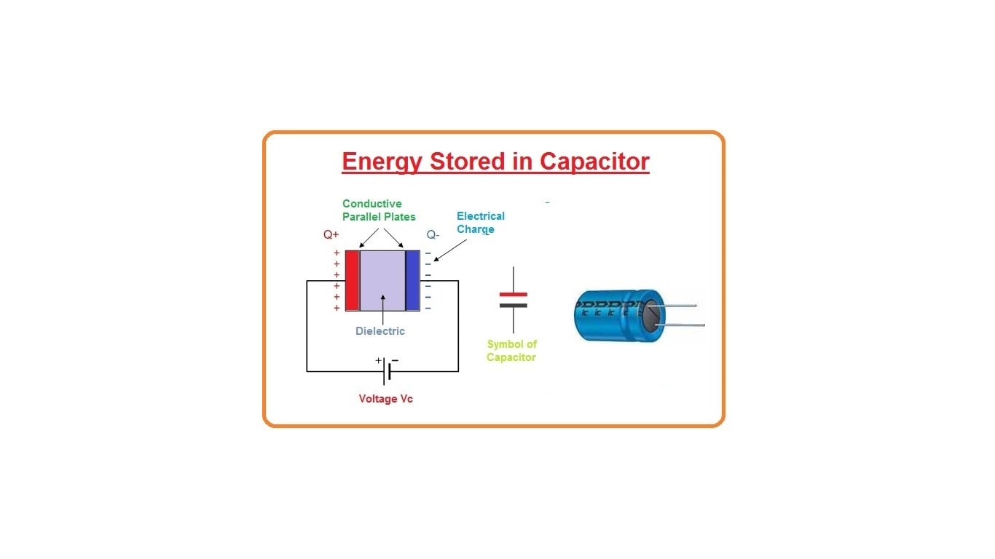
Electric energy storage
How does it work?
Advantages
Disadvantages
Notes:
This is the only method that directly stores electricity in a capacitor.
How does it work: Imagine a light bulb in place of the voltage. This capacitor is already charged. The energy that was stored in the capacitor turns into light and heat the that comes out of the light bulb. Once the capacitor discharges itself and theres no more charges left to transfer the process stop and the light goes out.
Advantages: Small size They can be charged significantly faster than conventional batteries. The number of recharges is almost infinite and the lifetime is long. Disadvantage: Storage capacity is relatively small: less than 100kW.

Slide 16
Thank you for your attention

