Slide 1

Discover the Green Life with Robots 2023-1-HU01-KA210-VET-000156243 Funded by the European Union. Views and opinions expressed are however those of the author(s) only and do not necessarily reflect those of the European Union or the Tempus Public Foundation. Neither the European Union nor the granting authoriry can be held responsible for them.

Slide 2

Impact of Automation and Robotics on the Workforce
Discover the Green Life with Robots
2023-1-HU01-KA210-VET-000156243
Case Studies, Successes, and Challenges Across Industries

Slide 3
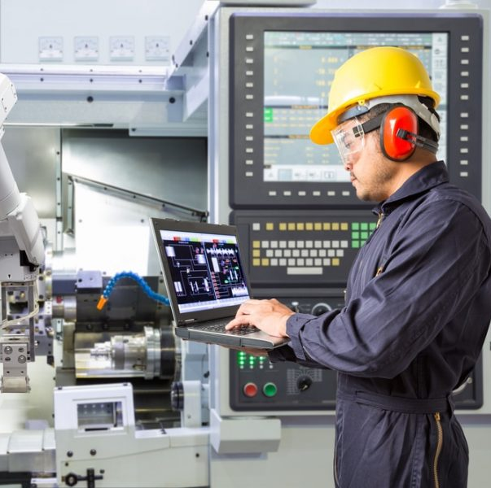
Introduction
Definition:
  Automation: Technology performing tasks with minimal human input.
  Robotics: Machines designed to execute tasks autonomously.
Significance:
  Drives efficiency and innovation.
  Has broad implications on employment and skills.

Slide 4

Agenda
1. Overview of Automation & Robotics
2. Detailed Case Studies
  Automotive Industry
  Warehousing and Logistics
  Healthcare
3. Cross-Industry Challenges
4. Success Factors & Key Learnings
5. Future Outlook
6. Q&A Session

Slide 5
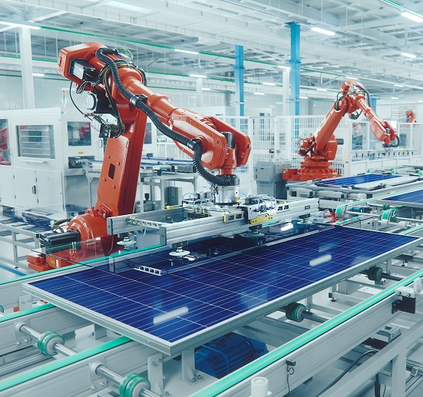
Automation & Robotics: An Overview
Definitions:
  Automation: Technology-driven task execution.
  Robotics: Machines that perform these tasks autonomously.
Impact on Workforce:
  Increased efficiency and productivity.
  Cost reduction and safety improvements.
  Displacement of traditional jobs.
  Need for workforce reskilling and upskilling.

Slide 6
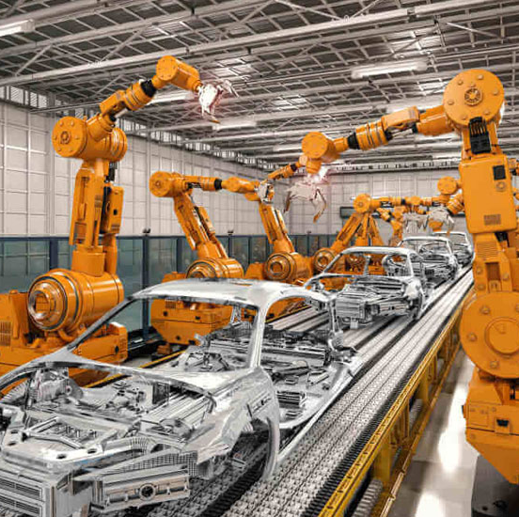
Cross-Industry Challenges
Common Challenges:
  Need for reskilling and upskilling the workforce.
  Economic and social implications of rapid technological change.
  Uneven adoption between large corporations and small businesses.
  Ethical and privacy concerns related to increased surveillance.
Discussion Point:
  Balancing efficiency gains with the human element.

Slide 7
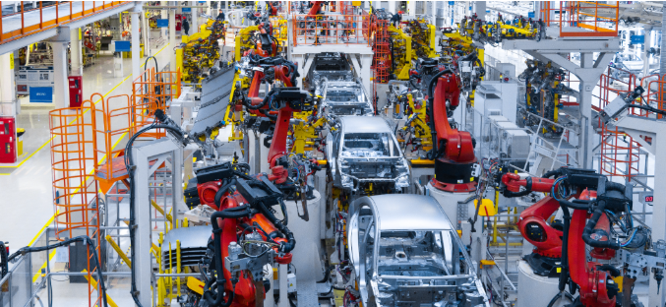

Automotive Industry
Use of Robotic Assembly Lines
Successes
  Increased Precision
  Improved Worker Safety
Challenges
  Job Displacement
  High Initial Investment
  Ongoing Employee Retraining

Slide 8
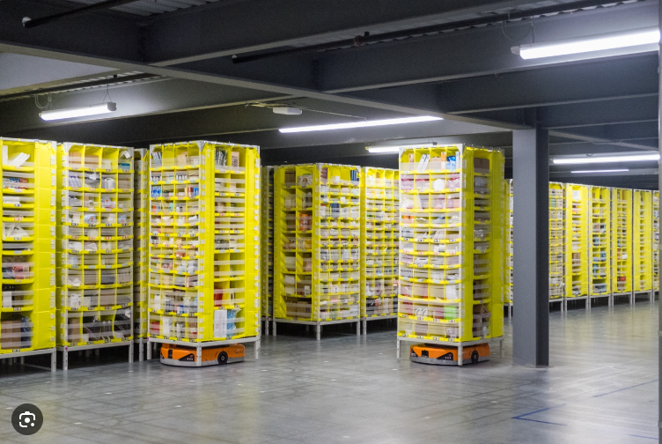

Warehousing and Logistics
Amazon’s Use of Robotics in Fulfillment Centers
Successes
  Improved Accuracy
  Reduced Human Error
Challenges
  Impact on Jobs
  Increased Monitoring
  Concerns Regarding Job Satisfaction

Slide 9
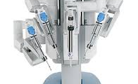

Healthcare
The da Vinci Surgical System
Pharmacy Operations
Successes:
  Enhanced Precision in Surgeries
  Reduced Patient Recovery Times
  Decreased Medication Errors
Challenges:
  High Maintenance Costs
  Regulatory and Training Hurdles
  Integration Challenges

Slide 10

Factors for Successful Implementation
Key Success Factors:
Strong leadership and strategic planning.
Investment in comprehensive training programs.
Partnerships between industry, government, and educational institutions.
Robust technological infrastructure and ongoing support.
Real-World Example:
Companies that have successfully integrated technology with strong workforce transition plans.

Slide 11
Key Learnings and Insights
Lessons Learned:
Automation boosts efficiency but necessitates a focus on human capital.
Transitioning smoothly requires addressing both technical and social dimensions.
No single approach fits all—each industry has its unique set of challenges and opportunities.
Takeaway Message:
Embrace change thoughtfully, integrating technology with strategic workforce development.

Slide 12
Future Outlook
Trends to Watch:
Further integration of AI with robotics.
Growing demand for roles requiring technical, creative, and strategic skills.
Policy Implications:
Need for policies that support reskilling and workforce transition.
Potential for public-private partnerships to smooth the changeover.
Discussion Point:
How can stakeholders collectively shape a sustainable future workforce?

Slide 13


Conclusion
Summary:
  Reviewed key case studies and examined both successes and challenges.
  Highlighted the importance of strategic planning and workforce development.
Final Thought:
  Embracing technology must go hand-in-hand with human capital development for sustainable growth.

Slide 14
Thank you for your attention!
Created and presented by:
Ábel
Ricsi
Dávid
Bors

