Slide 1

Funded by the European Union. Views and opinions expressed are however those of the author(s) only and do not necessarily reflect those of the European Union or the Tempus Public Foundation. Neither the European Union nor the granting authoriry can be held responsible for them.

Slide 2

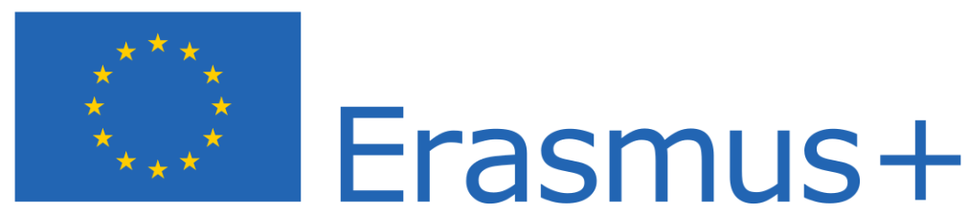
Discover the Green Life with Robots
2023-1-HU01-KA210-VET-000156243

Slide 3





Robots vs. Manpower: Advantages, Disadvantages, and Implications
Made by: Szőke Fanni
Kovács Krisztián
Fekete Dániel

Slide 4
AGENDA
Introduction
Defining robots and man power
Advantages of Using Robots
Disadvantages of Using Robots
Advantages of Using Manpower
Disadvantages of Using Manpower
Industry-Specific Comparisons
Ethical and Social Implications
Future Outlook
Conclusion & Discussion
01
02
03
04
05
06
07
08
09
10

Slide 5




Introduction

Slide 6






Defining Robots and Manpower
Key Differences
Robots
Manpower

Slide 7

Advantages of Using Robots
01
02
03
04
Efficiency & Productivity
Consistency & Precision
Work in Hazardous Environments
Long-Term Cost Reduction

Slide 8




Disadvantages of Using Robots
01
03
Limited Adaptability
High Initial Costs
02
04
Ethical & Security Concerns
Job Displacement

Slide 9
Advantages of Using Manpower
01
02
03
04
Higher Operational Costs
Human Error & Fatigue
Workplace Safety Risks
Limited Scalability

Slide 10
Disadvantages of Using Manpower
01
03
Workplace Safety Risks
Higher Operational Costs
02
04
Human Error & Fatigue
Limited Scalability

Slide 11

Industry-Specific Comparisons
Manufacturing
Healthcare
Retail & Customer Service
Construction & Agriculture

Slide 12


Ethical and Social Implications
Impact on Employment
Need for Reskilling & Upskilling
Ethical AI & Decision-Making
Balancing Technology & Humanity

Slide 13

Future Outlook
Emerging Trends
Human-AI Collaboration
Policy & Regulation

Slide 14


Conclusion & Discussion
01
02
Key Takeaways
Open Discussion

Slide 15

THANK YOU!

Slide 16
Disadvantages of Using Robots
High Initial Costs
01
Limited Adaptability
04
02
Job Displacement
03
Ethical & Security Concerns

Slide 17
Advantages of Using Manpower
Flexibility & Adaptability
Creativity & Innovation
Interpersonal & Emotional Skills
Ethical Responsibility

Slide 18




RESOURCE PAGE

